Slide 1
COMP 3500
Introduction to Operating Systems
Project 4 – Processes and System Calls
Part 3: Adding System Calls to OS/161
Dr. Xiao Qin
Auburn University
http://www.eng.auburn.edu/~xqin
xqin@auburn.edu

Slide 2
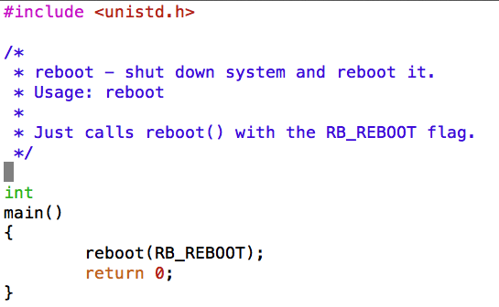
Use System Call: sys_reboot()
Q1: Is this program an application or a part of the kernel?
In src/sbin/reboot/reboot.c
How to run the reboot program?
Type “p /sbin/reboot”
Notes:
/sbin is under ~/cs161/root
All executable code can be found here.
In a real operating system, the kernel's main function is to provide support for user-level programs. Most such support is accessed via "system calls." We give you one system call, reboot(), which is implemented in the function sys_reboot() in src/kern/main/main.c. In GDB, if you put a breakpoint on sys_reboot and run the "reboot" program (by typing "p /sbin/reboot" at the OS/161 menu prompt), you can use "backtrace" to see how it got there.

Slide 3
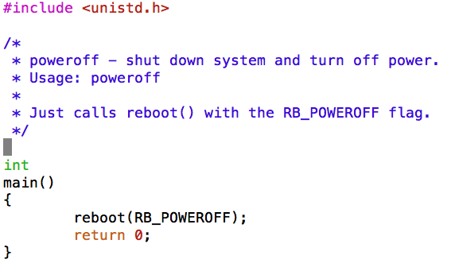
Use System Call: sys_reboot()
Another Example: In src/sbin/poweroff/poweroff.c
How to run the poweroff program?
Type “p /sbin/poweroff”
Notes:
In a real operating system, the kernel's main function is to provide support for user-level programs. Most such support is accessed via "system calls." We give you one system call, reboot(), which is implemented in the function sys_reboot() in src/kern/main/main.c. In GDB, if you put a breakpoint on sys_reboot and run the "reboot" program (by typing "p /sbin/reboot" at the OS/161 menu prompt), you can use "backtrace" to see how it got there.

Slide 4
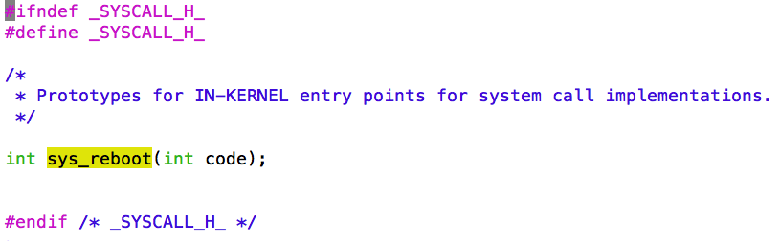
System Call: sys_reboot()
In src/kern/include/syscall.h
Notes:
you have to implement the interface between user-mode programs ("userland") and the kernel. You will be provided part of the code needed for this assignment, and you are required to design and implement the missing pieces. Your job also includes implementation of the subsystem that keeps track of the multiple tasks you will have in the future. Importantly, you need to design data structures for "process" (Hint: look at kernel include files of your favorite operating system for suggestions,

Slide 5
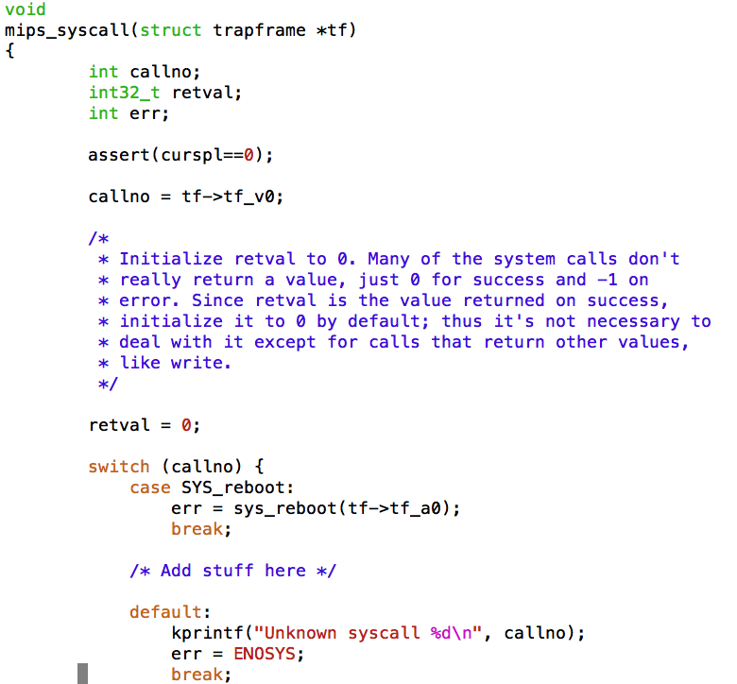
In src/kern/arch/mips/mips/syscall.c
Notes:
/*
* System call handler.
*
* A pointer to the trapframe created during exception entry (in
* exception.S) is passed in.
*
* The calling conventions for syscalls are as follows: Like ordinary
* function calls, the first 4 32-bit arguments are passed in the 4
* argument registers a0-a3. In addition, the system call number is
* passed in the v0 register.
*
* On successful return, the return value is passed back in the v0
* register, like an ordinary function call, and the a3 register is
* also set to 0 to indicate success.
*
* On an error return, the error code is passed back in the v0
* register, and the a3 register is set to 1 to indicate failure.
* (Userlevel code takes care of storing the error code in errno and
* returning the value -1 from the actual userlevel syscall function.
* See src/lib/libc/syscalls.S and related files.)
*
* Upon syscall return the program counter stored in the trapframe
* must be incremented by one instruction; otherwise the exception
* return code will restart the "syscall" instruction and the system
* call will repeat forever.
*
* Since none of the OS/161 system calls have more than 4 arguments,
* there should be no need to fetch additional arguments from the
* user-level stack.
*
* Watch out: if you make system calls that have 64-bit quantities as
* arguments, they will get passed in pairs of registers, and not
* necessarily in the way you expect. We recommend you don't do it.
* (In fact, we recommend you don't use 64-bit quantities at all. See
* arch/mips/include/types.h.)
*/

Slide 6
Which function calls mips_syscall()?
exception.S
mips_trap()
mips_syscall()
See cs161/kern/arch/mips/mips
Notes:
mips_trap() and mips_syscall() can be found in cs161/kern/arch/mips/mips

Slide 7
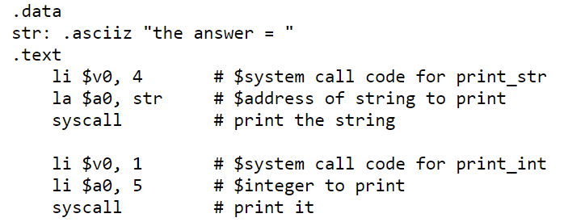
Which function calls exception.S?
A user program
  Loads a system call code into register $v0
  Loads the arguments into registers $a0, ..., $a3
System calls that return values
  Put their result in register $v0

Slide 8
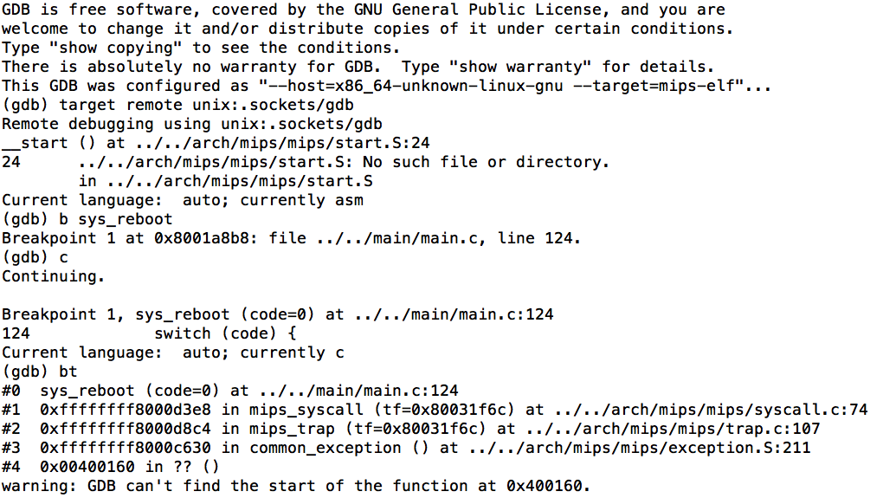
Using cs161-gdb to trace sys_reboot()? b sys_reboot type “p /sbin/reboot” at the OS161 menu prompt bt (back trace)

Slide 9
User-Level Interface for System Calls src/include/unistd.h
This file contains the user-level interface definition of the system calls for OS/161
Note that the user-level interface defined in unistd.h is different from that of the kernel functions that you will define to implement these calls.
You need to declare the kernel functions in
  src/kern/include/syscall.h
Notes:
Demonstrate file: ~/cs161/src/include/unistd.h
Also show: ~/cs161/src/kern/include/syscall.h

Slide 10
Step 1: Configuration
Configure the source code tree
  %cd ~/cs161/src
  %./configure
Configure a kernel named ASST2
  %cd ~/cs161/src/kern/conf
  %./config ASST2

Slide 11
Step 2: System Call Implementation
2.1 Create a System Call Implementation File
  ~/cs161/src/kern/userprog

Slide 12
Step 2.1: System Call Implementation
Example: getpid_syscall.c
  #include <types.h>
  #include <syscall.h>
  #include <thread.h>
  #include <curthread.h>
  /* Sample implementation of sys_getpid() */
  int
  sys_getpid(pid_t *retval)
  {
  *retval = curthread->t_pid;
  return 0;
  }

Slide 13
Step 2.1: System Call Implementation
Update data structure struct thread in kern/include/thread.h by adding the following data item:
  pid_t t_pid;
Notes:
Show source code file: ~/cs161/src/kern/include/thread.h

Slide 14
Step 2.2: Update Configuration File and Reconfigure the Project
Now you can update the configuration file (i.e., conf.kern) located in src/kern/conf
The following line should be added:
  file userprog/getpid_syscall.c
Reconfigure the project (see Step 1 for details)
Notes:
Show conf.kern

Slide 15
Step 2.3: Update the header file of system call functions in the kernel
The prototype of sys_getpid may be included in the following file:
  ~/cs161/src/kern/include/syscall.h
Add the following function prototype in the above file:
  int sys_getpid(pid_t *retval);

Slide 16
Step 2.4: Update the system call handler syscall.c
The system call handler syscall.c is located in the following directory:
~/cs161/src/kern/arch/mips/mips
Add the following segment in the switch-case statement of the mips_syscall() function in syscall.c
case SYS_getpid:
err = sys_getpid(&retval);
break;

Slide 17
Step 2.5: Rebuild the OS/161 Kernel
Follow the commands below to rebuild the kernel.
  %cd ~/cs161/src/kern/compile/ASST2
  %make depend
  %make
  %make install

Slide 18
Step 3: Test System Calls
Step 3.1 Create a User Program for the New System Call
Step 3.2 Run the User Program in OS/161

Slide 19
Step 3.1-1 Create a new directory using forktest as a template
We place all the test programs in the following directory:
  ~/cs161/src/testbin
Each test program and its associated files (e.g., Makefile) are organized in a dedicated directory.
Create a new directory using forktest as a template
  %cd ~/cs161/src/testbin
  %cp –r forktest getpidtest

Slide 20
Step 3.1-2
Change source code name
  %cd getpidtest
  %mv forktest.c getpidtest.c

Slide 21
Step 3.1-3
Modify getpidtest.c
  #include <unistd.h>
  #include <stdio.h>
  int main() {
  int mypid;
  mypid = getpid();
  reboot(RB_REBOOT);
  return 0;
  }

Slide 22
Step 3.1-4
Modify Makefile and depend.mk
Modify Makefile and depend.mk by replacing forktest with getpidtest

Slide 23
Step 3.1-5
Compile getpidtest.c
Compile getpidtest.c using cs161-gcc. This can be done through running Makefile as below.
    %make
The make utility program compile getpidtest.c and generate an execute file called getpidtest

Slide 24
Step 3.1-6
Copy the executable file to the root directory
Copy the executable file getpidtest into ~/cs161/root/testbin
%cp getpidtest ~/cs161/root/testbin/getpidtest
The above executable file will be loaded by OS/161 through the p command in the main menu.

Slide 25
Step 3.2 Run the User Program in OS/161
You can follow the instructions below to run the testing program created in Step 3.1:
  %cd ~/cs161/root
  %./sys161 kernel
In the menu prompt type:
  p /testbin/getpidtest

Slide 26
Reference
A PDF file:
Project 4 Adding System Calls.pdf

